Slide 1
caArray User Community Meeting
1.x Update and 2.0 Development Status
Call in: 877-416-5524
Participant Passcode: 2627056
Centra: http://ncicb.centra.com
Meeting ID: array_aug8
August 8, 2007

Slide 2
Agenda
Upcoming Releases
  1.5.0.1
  1.5.0.2
  1.6
  Grid service on Production
  Data parsing
2.0 Update
  Where we are
  What are the expected results
  What we need from the user community

Slide 3
caArray 1.5.0.1 – Patch Release
Released July 3
Fixed a poor performing Array search

Slide 4
caArray 1.5.0.2 – Patch Release
We are currently planning for a patch release to fix the association between DerivedBioAssay, MeasuredBioAssayData, DerivedBioAssayData and Experiment
  Affects users of the MAGE-OM API
This patch will be provided with a patch installer
  Upgrading will not require rebuilding the application
To be released in approximately two weeks

Slide 5
caArray 1.6 – Maintenance Release
To be released mid-September
A number of issue that have been identified when loading MAGE-ML files that have been created from MAGE-TAB files using the EBI’s tab2MAGE converter

Slide 6
Data Parsing
We are incrementally parsing data into the Production instance of caArray
  Data that is parsed into the database is available as a BioDataCube through the MAGE-OM API
Three Experiments have been loaded to date
  <list these here>
We are next targeting loading of NCI-60 expression data

Slide 7
Grid service
The 1.5 grid service has not been released to Production, but is available on our Staging (pre-production) server
caB2B team has been using the grid service extensively and we have made client-side fixes based on their feedback
We plan to release the grid service to Production within the next two weeks, pending resolution on one additional issue

Slide 8

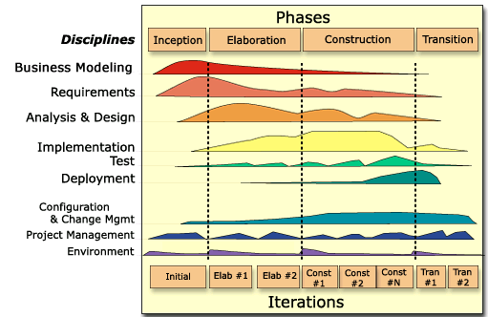
caArray 2.0 - Where We Are
2.0 Elaboration Iteration 1
  Completed
2.0 Elaboration Iteration 2
  Begun

Slide 9
Results of Elaboration Iteration 1
Project Management:
  Refine 2.0 Schedule, Detail E2 Schedule
Requirements:
  Wrote prioritized Use Cases
  Established Community Reviewers of major functional areas
Analysis and Design
  Strategy for Parsing, binary Storage
Implementation
  Begin architectural proof of Upload, Extraction

Slide 10
Goals of Elaboration Iteration 2
Project Management
  Refine 2.0 Schedule, Detail C1 Schedule
Requirements
  Continue to gather feedback on Use Cases from community members
  Incorporate feedback on Use Cases
  Create wireframes for targeted UCs; user interface design
Analysis and Design
  Finalize domain model
  Targeted UC A&D – Validation, Permissions
Implementation
  Complete MAGE-TAB parsing
  Grid service
  Validation, Security

Slide 11
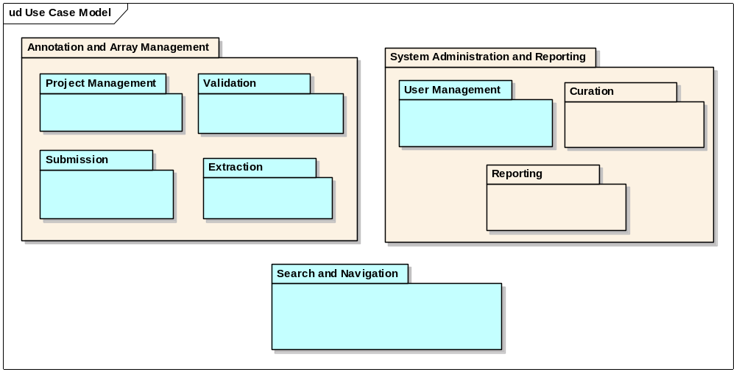
2.0 Use Case Model

Slide 12
Specific Questions
Terms to use for logical ordering of data
  “Project” vs. “Experiment” vs. other?
  “Program” vs. “Study” vs. other?

Slide 13
What we need from you and when
Initial priority acquired – thank you
Initial feedback on priority use cases – thank you
Next round of feedback
  Logical model – overview to be presented at Friday’s Analytical Services Best Practices meeting
  Updated use cases
  Wireframes

Slide 14
Continuing Engagement Model
Continue Monthly Meetings
G-Forge site for 2.0 is available that indicates needs, features, use cases and test cases
  We will continue to publish regularly and investigate forums and surveys for targeted feedback
G-forge site: https://gforge.nci.nih.gov/projects/caarray2/

Slide 15
Next Steps
Please visit G-Forge: https://gforge.nci.nih.gov/projects/caarray2/ to view the prioritization of features and use cases (Tracker items)
Results of Elaboration Iteration 2 September 6th, 2007
Next meeting date: TBA but anticipated September 12, 2007

